Slide 1
Professional Development
PD Funding Requests

Slide 2
The PD Committee
The PD Committee serves to solicit, collect, and evaluate PD Funding Proposals.
Proposals are evaluated to find the benefits to the students and the college.
The Committee follows the Guidelines listed online at: https://www.mclennan.edu/professional-and-organizational-development/committees.html

Slide 3
Applying for Funding
Any full-time regular professional employee may apply for professional development funding.
Visit www.mclennan.edu/professional-and-organizational-development/pdforms
Download and complete the Professional Employees Professional Development Proposal Form
Submit the PD Proposal Form, any supporting documents, and your PD Plan to Mikken at mcanham@mclennan.edu by the last working Wednesday of the month.

Slide 4
Completing the Funding Application
PD Funding Application Tips:
Include your travel dates, not only the dates you will be at the event.
Get permission from Dr. Benson before using a 3rd party vendor such as Expedia.
Us the https://www.gsa.gov/travel/plan-book/per-diem-rates site to check per-diem rates in the city you are traveling to.
Include supporting documentation.
Read the MCC Travel Procedures listed in the Budget Administration Policy D-III-b.

Slide 5
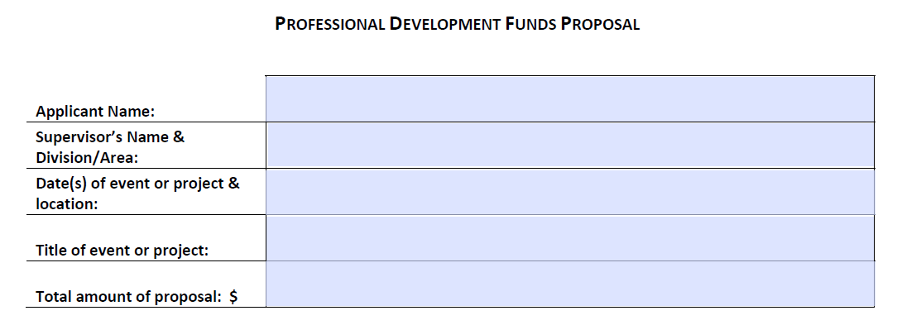
Be sure to include your travel dates as well as the dates of the event.

Slide 6
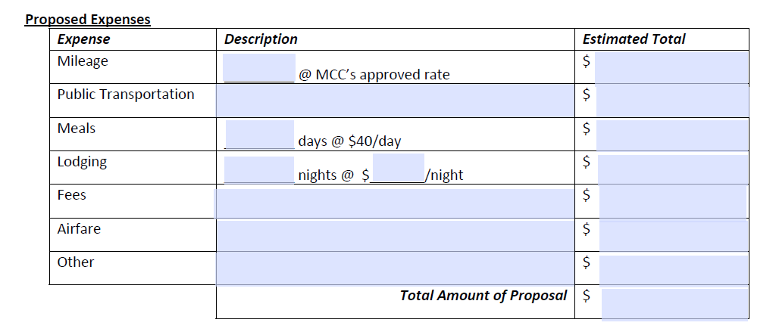
Include a Google map showing the mileage.
Be sure to check the per diel rates for the city you will be visiting on the gsa.gov/travel web site and include a screen shot. Note: the amount is per day, not a total for the trip.

Slide 7
Processing
Mikken will send all applications for approval to the appropriate supervisor, Director/Dean, and Vice President. They are reviewing that the activity is relevant to your position and approving your travel, if applicable.
Supervisors may also make contributions to the funding.
Once approved, the proposal is presented to the PD Committee.

Slide 8
Funding Review
Applications must be reviewed and approved prior to the event and prior to any expenditures being paid for PD Funding to be applied.
The PD Committee may chose to fully or partially fund or to decline funding for any application.
The PD Committee Chairperson will email the applicant with the funding decision and instructions on what to do next.

Slide 9
Approved for Funding
Read and Complete Travel Form
We suggest taking the Travel Forms PD class. ☺
Have questions? You can always call or email.

Slide 10
The Travel Form
Complete the top section of the form
Gather all signatures
Turn form into PD Office
The PD Office will sign, add the approved amounts, and submit to the business office. PD is only able to pay the line item amounts approved by the PD Committee.
Travel forms must be on file with the business office BEFORE you travel.

Slide 11
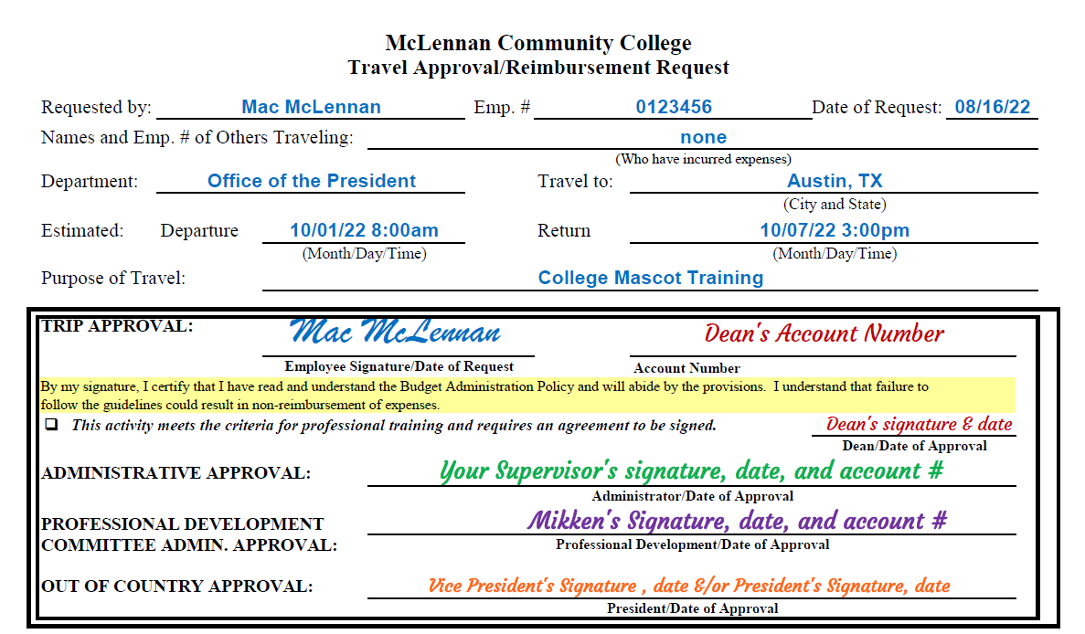

Slide 12
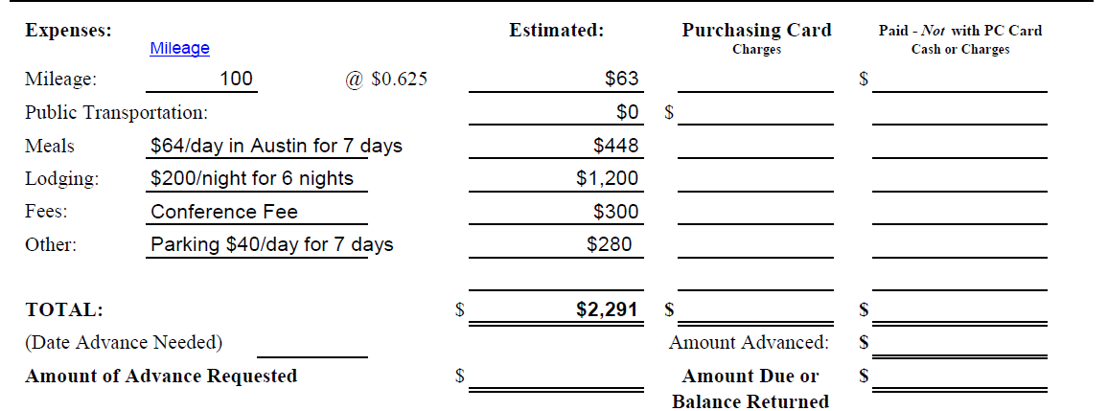
These amounts must match the amounts on the PD Funding Application.
PD will pay UP TO the amounts approved by the PD Committee, PER LINE ITEM.

Slide 13
When You’re Back
Schedule a time to process your travel form with Mikken the week you get back.
Be sure to keep your ORIGINAL receipts!
Receipts must show the item(s) purchases, amount paid, method of payment, and “Paid” status.
Any/all purchase made with a P-Card will be paid directly by submitting the P-card statement and original receipts to Mikken.
Payment made with a personal card will be reimbursed with a check issued by the business office and mailed to the recipient.
PD will pay up to, not more than, the amounts approved by the PD Committee. This is PER LINE ITEM.

Slide 14
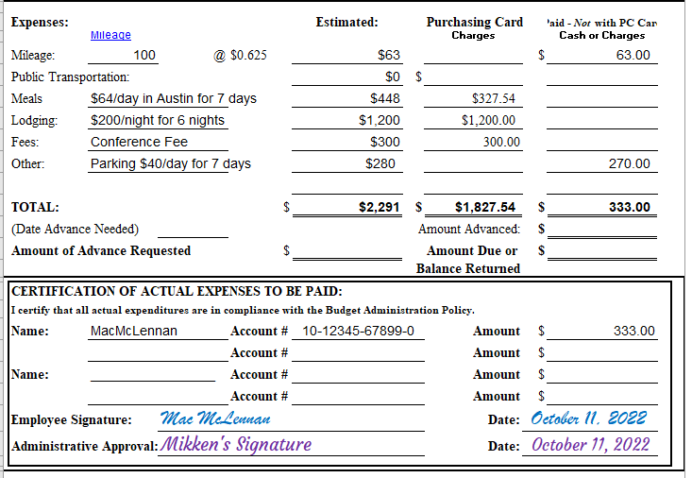
Mikken will complete these sections with you.

Slide 15
PD Follow-Up Form
A PD Follow-Up Form will be included in your awards email from the PD Committee Chair.
Provide a summary of your experience including what knowledge was gained by the experience.
By accepting PD Funding you are agreeing to present your findings, if requested, at PD Day, a PD Class, or a Department Meeting.
Submit your summary to Mikken the week you return.

Slide 16
Have Questions?
Professional and Organizational Development
Mikken Canham
x8647
LTC 218C
mcanham@mclennan.edu
Business Office
Melree Paris
8671
mparis@mclennan.edu

Slide 17
Resources
Professional Development Committees: https://www.mclennan.edu/professional-and-organizational-development/committees.html
PD Forms: https://www.mclennan.edu/professional-and-organizational-development/pdforms.html
U.S. General Services Administration-Per Diem Rates: https://www.gsa.gov/travel/plan-book/per-diem-rates
Budget Administration Policy: https://www.mclennan.edu/employees/policy-manual/docs/D-III-B.pdf

